Slide 1

Geometry
Unit 8, Lesson 2 Using Properties of Parallelograms Volume 2, pg. 13

Slide 2


Benchmarks
MA.912.GR.1.4
Prove relationships and theorems about parallelograms. Solve mathematical and real-world problems involving postulates, relationships, and theorems of parallelograms.
MA.912.LT.4.10
Judge the validity of arguments and give counterexamples to disprove statements.
volume 2, pg. 13

Slide 3
Integrated Mathematical Thinking and Reasoning Standards
MA.K12.MTR.1.1 Actively participate in effortful learning both individually and collectively.
MA.K12.MTR.4.1 Engage in discussions that reflect on the mathematical thinking of self and others.
MA.K12.MTR.5.1 Use patterns and structure to help understand and connect mathematical concepts.
MA.K12.MTR.6.1 Assess the reasonableness of solutions.
volume 2, pg. 13

Slide 4

Learning Target
I can determine if a quadrilateral is a parallelogram using properties of a parallelogram.
volume 2, pg. 13

Slide 5

Warm-Up
volume 2, pg. 13

Slide 6
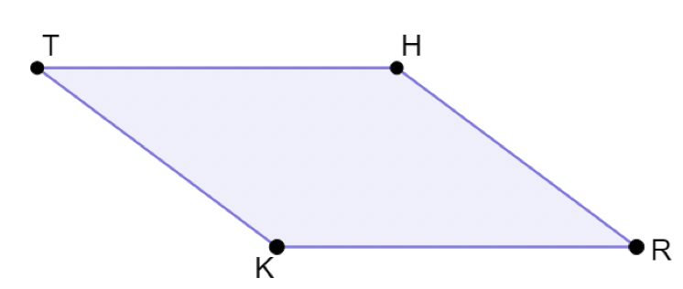
8.2.1 Warm-Up: Bell Work
Given: $∠RKT≅∠RHT$ and $∠KTH≅∠KRH$
Prove:$THRK$ is a parallelogram
volume 2, pg. 13

Slide 7
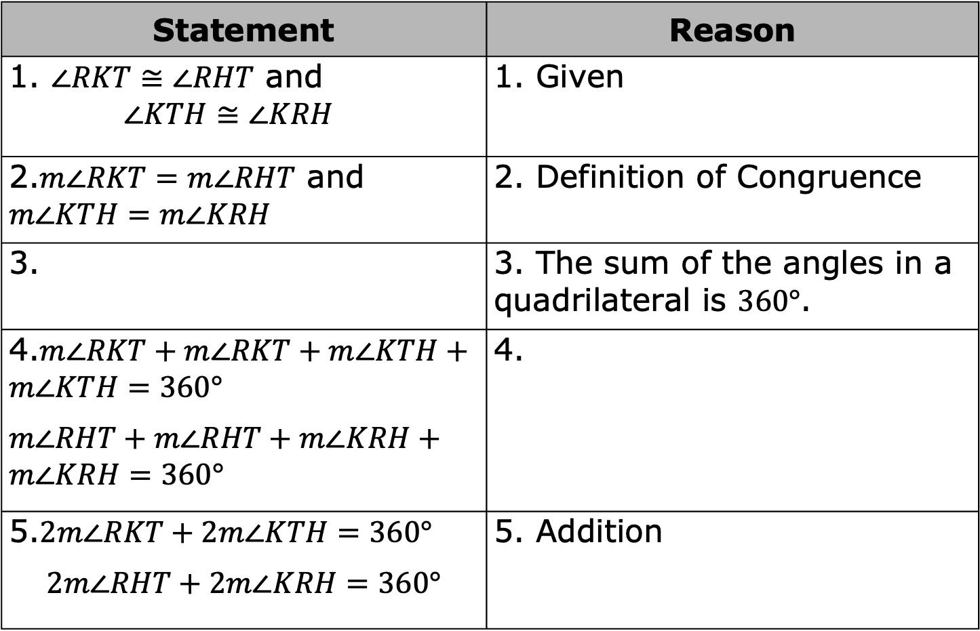
Statement | Reason
1. $∠RKT≅∠RHT$ and $$∠KTH≅∠KRH$$ | 1. Given
2.$m∠RKT=m∠RHT$ and $m∠KTH=m∠KRH$ | 2. Definition of Congruence
3. | 3. The sum of the angles in a quadrilateral is $360°$.
4.$m∠RKT+m∠RKT+m∠KTH+m∠KTH=360°$ $m∠RHT+m∠RHT+m∠KRH+m∠KRH=360°$ | 4.
5.$2m∠RKT+2m∠KTH=360°$ $$2m∠RHT+2m∠KRH=360°$$ | 5. Addition
volume 2, pg. 13

Slide 8
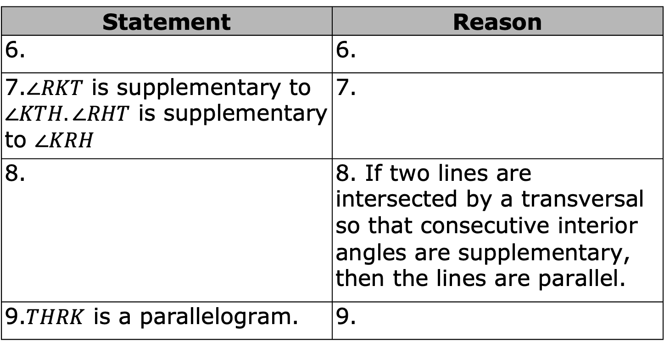
Statement | Reason
6. | 6.
7.$∠RKT$ is supplementary to $∠KTH. ∠RHT$ is supplementary to $∠KRH$ | 7.
8. | 8. If two lines are intersected by a transversal so that consecutive interior angles are supplementary, then the lines are parallel.
9.$THRK$ is a parallelogram. | 9.
volume 2, pg. 13

Slide 9

Collaboration
volume 2, pg. 14

Slide 10

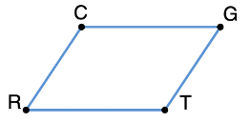

8.2.2 Collaboration: Determining Parallelograms
Work with your partner to determine if the figure given is a parallelogram. Finish the statements that follow.
$CGTR$ is shown. In the figure, $m∠C=113°$, $m∠G=67°$ and $m∠T=103°$.
I can conclude …
I know this because …
volume 2, pg. 14

Slide 11
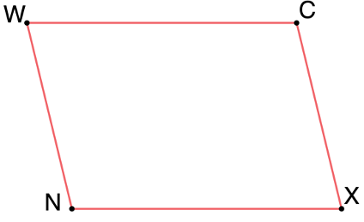

$WCXN$ is shown with sides $\overline{WC}$ and $\overline{NX}$ each measuring $15$ cm and sides $\overline{WN}$ and $\overline{CX}$ each measuring $9$ cm.
I can conclude …
I know this because …
volume 2, pg. 14

Slide 12
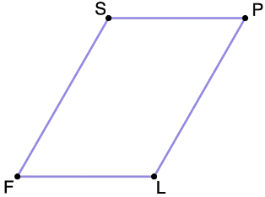

In $SPLF$, $m∠S=120°,$ and $m∠F=\left(20x+47\right)°.$ If x=1/2, determine whether the figure is a parallelogram.
I can conclude …
I know this because …
volume 2, pg. 15

Slide 13
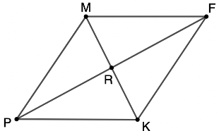
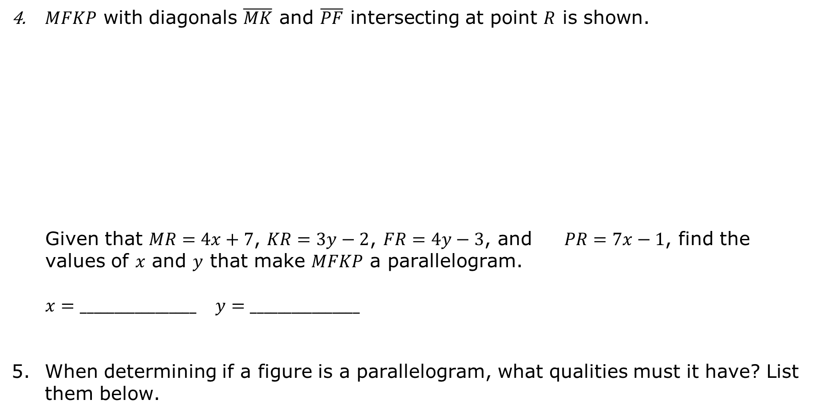
$MFKP$ with diagonals $\overline{MK}$ and $\overline{PF}$ intersecting at point $R$ is shown.
Given that $MR=4x+7$, $KR=3y−2$, $FR=4y−3$, and $PR=7x−1$, find the values of $x$ and $y$ that make $MFKP$ a parallelogram.
$x=_________________$ $y=________________$
When determining if a figure is a parallelogram, what qualities must it have? List them below.
volume 2, pg. 15

Slide 14

Guided Practice
volume 2, pg. 16

Slide 15

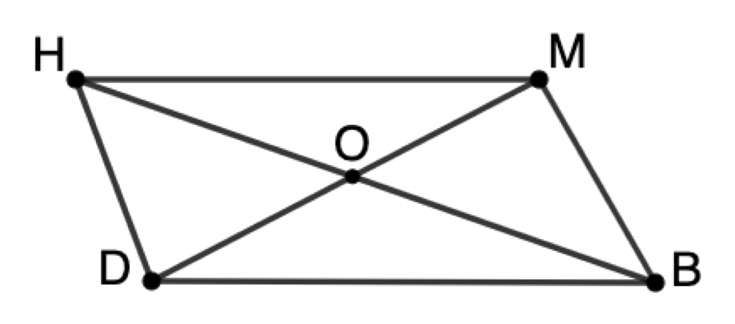
8.2.3 Guided Practice: Is It a Parallelogram?
Use the figure given to fill in the chart below.
volume 2, pg. 16

Slide 16
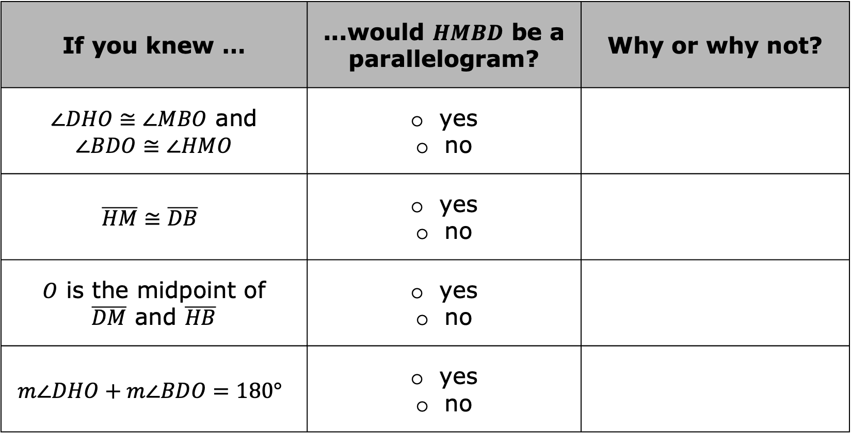
If you knew … | ...would $HMBD$ be a parallelogram? | Why or why not?
$∠DHO≅∠MBO$ and $$∠BDO≅∠HMO$$ | yes no
$$\overline{HM}≅\overline{DB}$$ | yes no
$O$ is the midpoint of $\overline{DM}$ and $\overline{HB}$ | yes no
$$m∠DHO+m∠BDO=180°$$ | yes no
volume 2, pg. 16

Slide 17
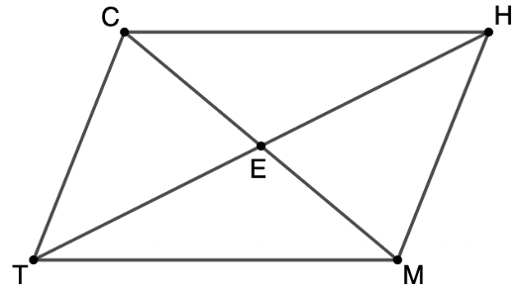
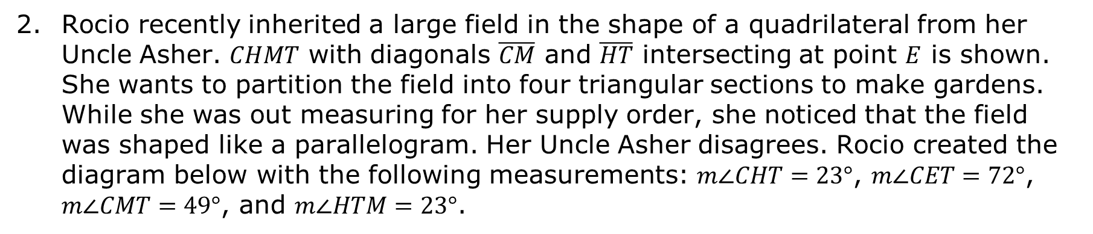
Rocio recently inherited a large field in the shape of a quadrilateral from her Uncle Asher. $CHMT$ with diagonals $\overline{CM}$ and $\overline{HT}$ intersecting at point $E$ is shown. She wants to partition the field into four triangular sections to make gardens. While she was out measuring for her supply order, she noticed that the field was shaped like a parallelogram. Her Uncle Asher disagrees. Rocio created the diagram below with the following measurements: $m∠CHT=23°$, $m∠CET=72°$, $m∠CMT=49°$, and $m∠HTM=23°$.
volume 2, pg. 16

Slide 18
Who is correct?
How do you know?
volume 2, pg. 16

Slide 19

Try It
volume 2, pg. 17

Slide 20

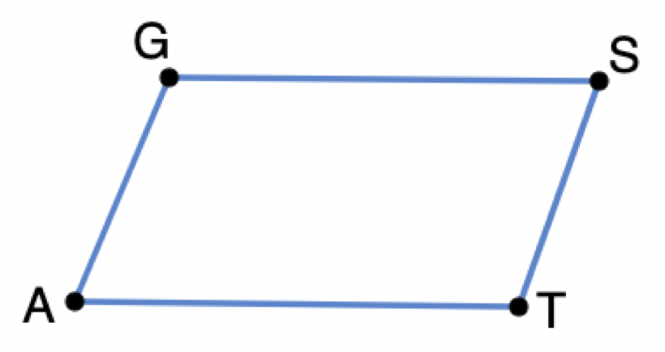
8.2.4 Try It: Parallelograms and Algebra
Quadrilateral $GSTA$ is shown where $GS=3x−1$, $ST=2y−3$, $AT=11$, and $GA=8$.
volume 2, pg. 17

Slide 21
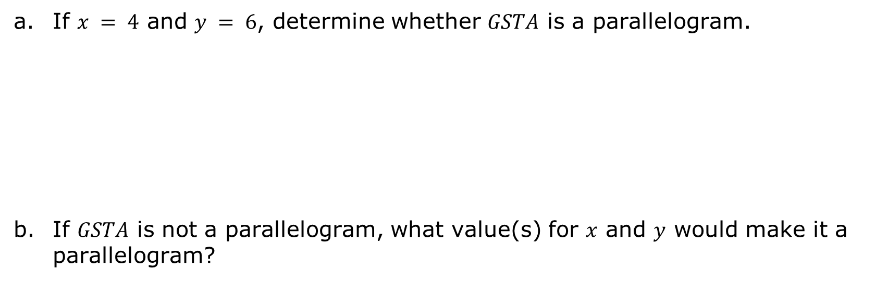
If $x = 4$ and $y = 6$, determine whether $GSTA$ is a parallelogram.
If $GSTA$ is not a parallelogram, what value(s) for $x$ and $y$ would make it a parallelogram?
volume 2, pg. 17

Slide 22
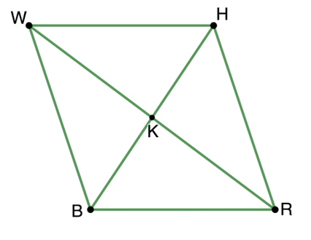

$WHRB$ is shown, where diagonals $\overline{WR}$ and $\overline{HB}$ intersect, such that $WK=−y+4$, $RK=\frac{1}{3}x+5$, $HK=5x−6$, and $BK=11+y$.
If $x=3$ and $y=−2$, determine whether $WHRB$ is a parallelogram.
If $WHRB$ is not a parallelogram, what value(s) for $x$ and $y$ would make it a parallelogram?
volume 2, pg. 17

Slide 23
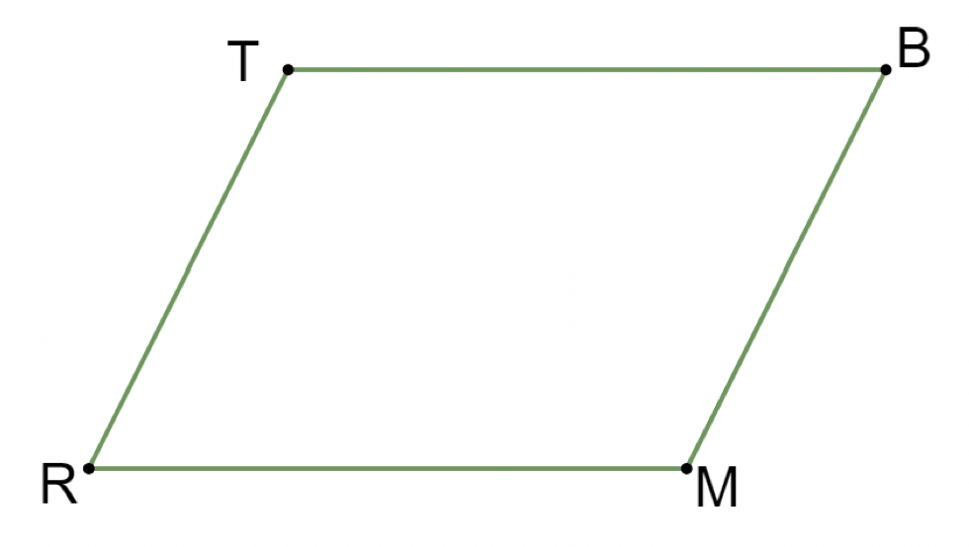
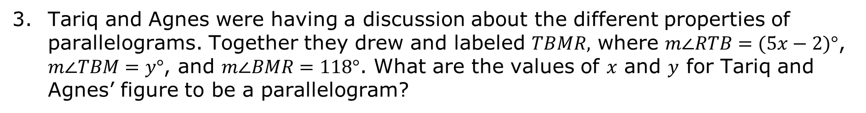
Tariq and Agnes were having a discussion about the different properties of parallelograms. Together they drew and labeled $TBMR,$ where $m∠RTB=(5x−2)°$, $m∠TBM=y°$, and $m∠BMR=118°$. What are the values of $x$ and $y$ for Tariq and Agnes’ figure to be a parallelogram?
volume 2, pg. 18

Slide 24

Wrap-Up
volume 2, pg. 18

Slide 25
8.2.5 Wrap-Up: Cool Down
Check the property that is always true about the polygon.
Properties of Figure | Types of Polygons
 | Quadrilateral | Parallelogram
Only one set of parallel sides
Two sets of parallel sides
Two sides of equal length
Consecutive angles are supplementary.
volume 2, pg. 18

Slide 26
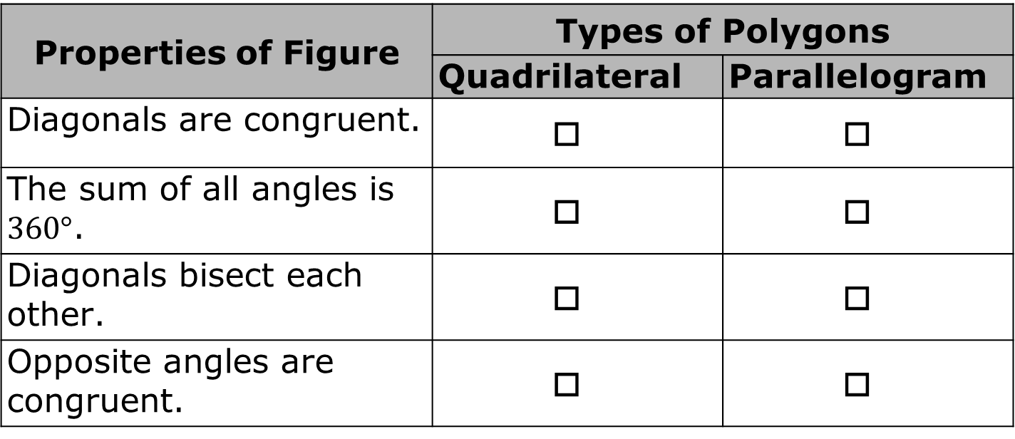
Properties of Figure | Types of Polygons
 | Quadrilateral | Parallelogram
Diagonals are congruent.
The sum of all angles is $360°$.
Diagonals bisect each other.
Opposite angles are congruent.
volume 2, pg. 18

